Slide 1
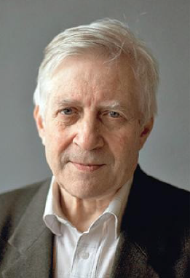
Kolya
Nikolai Semionovich Kardashev
remembered by:
L. Fillippova, L. Gindilis, L. Gurvits,
Yu. Kovalev, S. Likhachev,
and V. Strelnitski

Slide 2
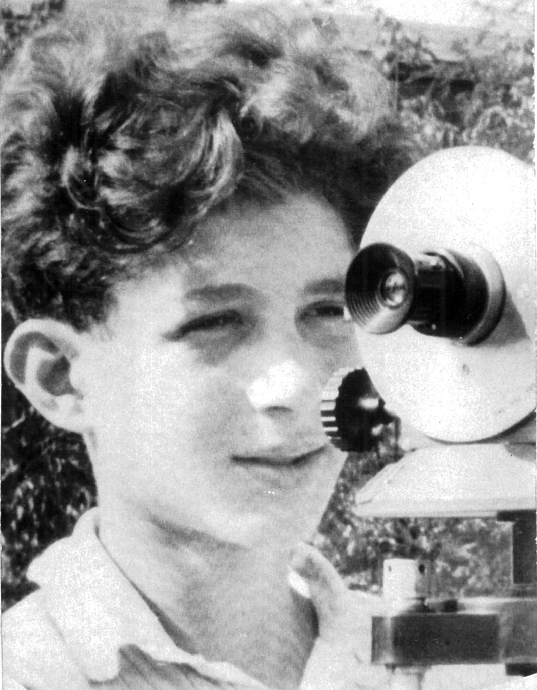

Slide 3
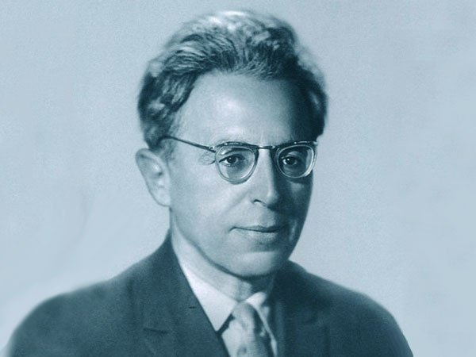
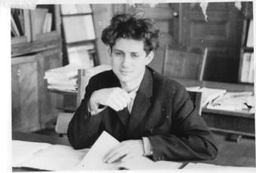
N.S. Kardashev (end of 1950s)
I.S. Shklovsky

Slide 4
An outstanding Communicator
Communication is an inherent property of Intelligence; CETI → CTI
Communication with colleagues (seminars, conferences, publications)
Communication with advisor (Prof. Shklovsky)

Slide 5
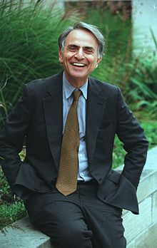
Carl Sagan, with whom Nikolai Kardashev discussed at the end of 1960s the plan of the historic first Soviet-American symposium on CETI/SETI (Byurakan 1971)

Slide 6
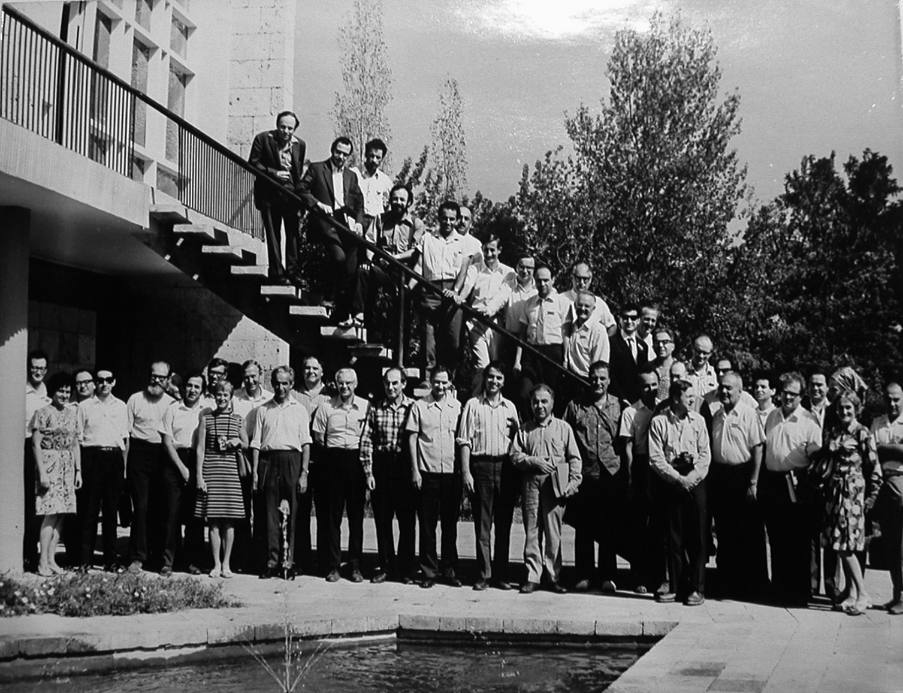
Soviet-American meeting on CETI/SETI
Byurakan, 1971

Slide 7
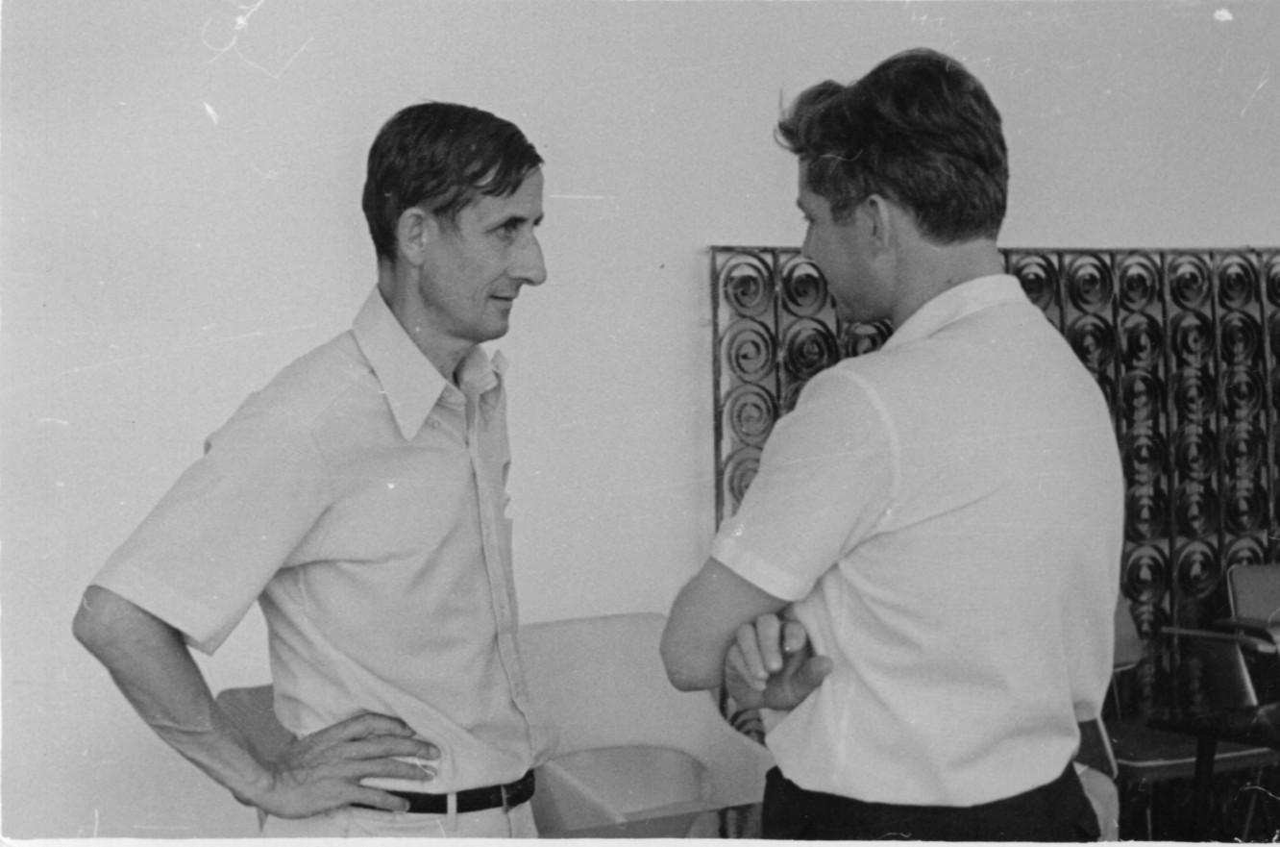
With Freeman Dyson (Byurakan, 1971)

Slide 8
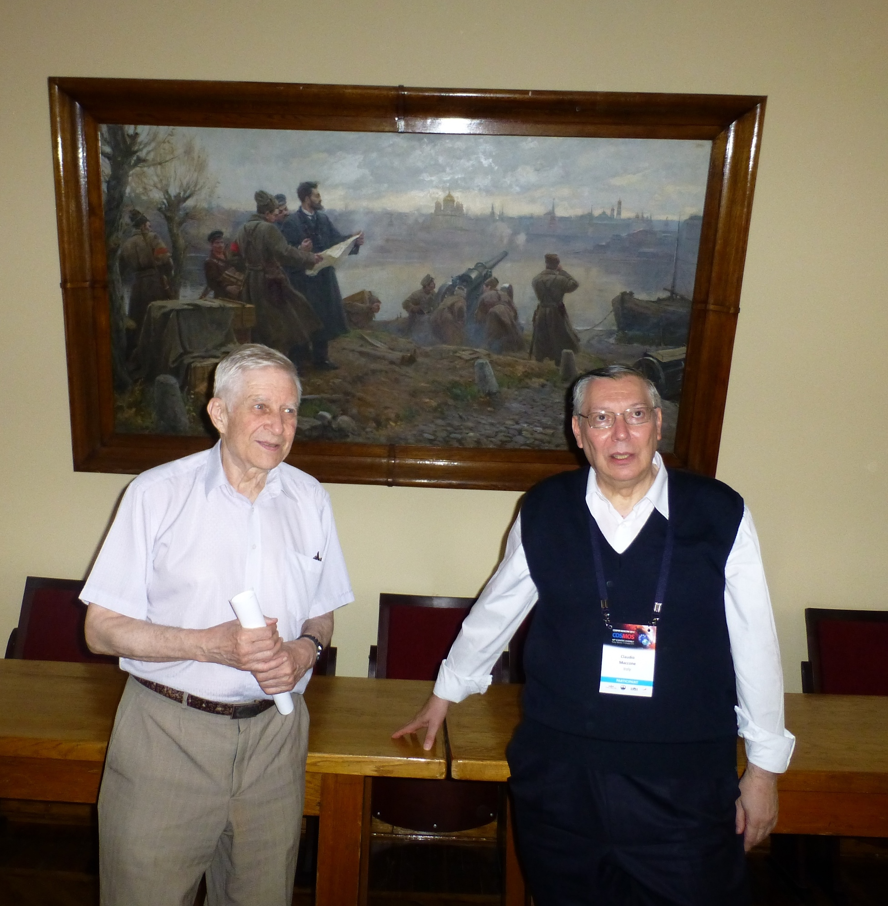
Moscow, GAISH
COSPAR 2014

Slide 9
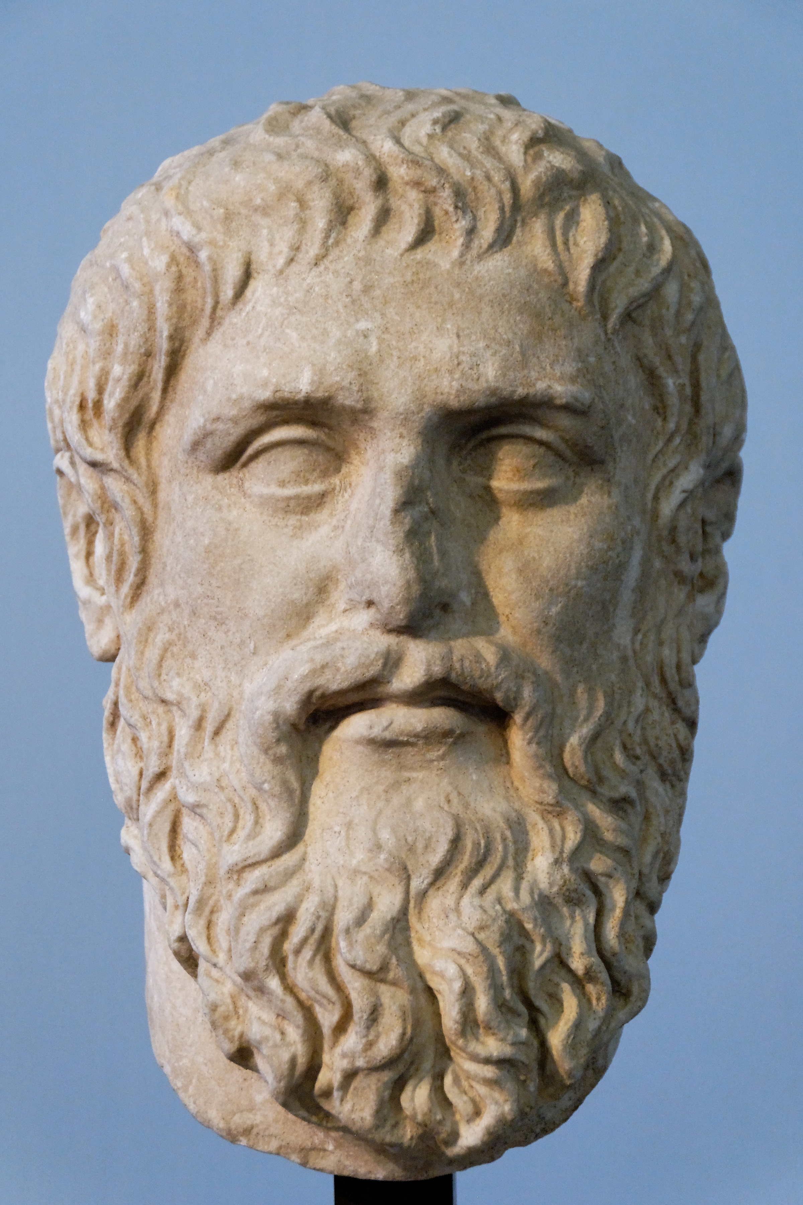
“Any phenomenon should not be declared artificial before all the natural explanations have been completely exhausted.”
I.S. Shklovsky (1971; “Presumption of naturality”)
“Amicus Plato, sed magis amica veritas.”
(“Plato is my friend, but truth is more friend.”)
Plato (4th c. BC)
“The presumption of naturality of every astronomical object… is coercion over creativity. Each scientist has the right to work within the framework of their belief system and intuition.”
N.S.Kardashev (1979)

Slide 10
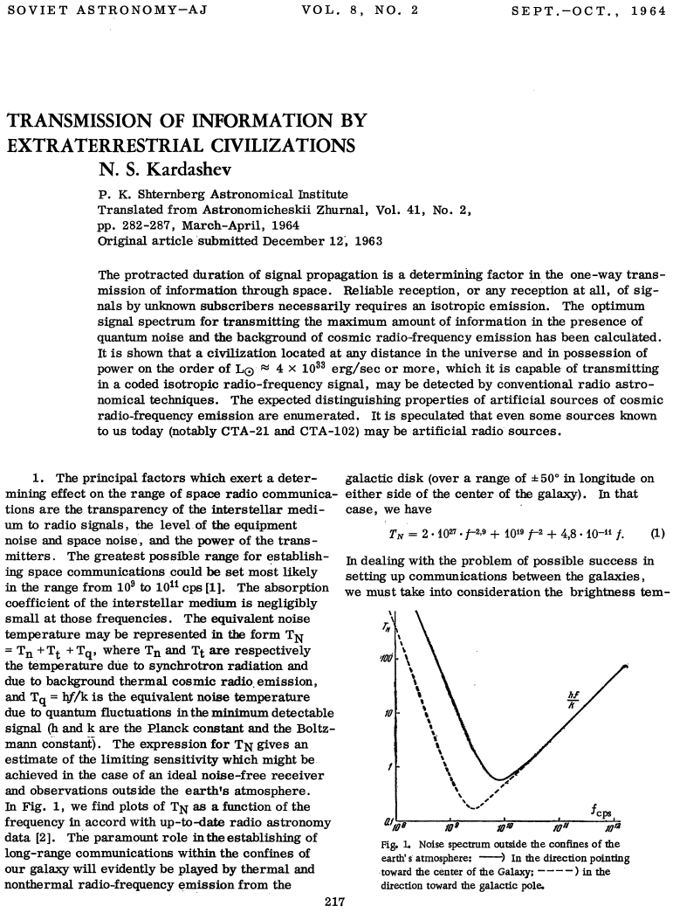
The seminal 1964
Classification of civilizations based on energy consumption
Optimal frequency range for search
Probable optimal spectrum of an artificial source
The rate of information transmission
Civilizations of Type 2 and 3: Continuous, isotropic, broad-band signal transmission (unilateral cosmic broadcasting)
Initiated the first Soviet CETI meeting where he presented these new results (1964).
Notes:
Here dwell a little on each of these topics

Slide 11
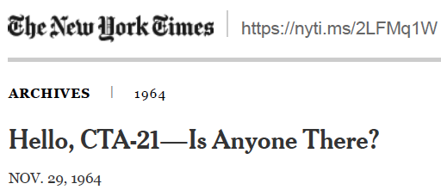
The CTA21 and CTA102 drama
Isaac Asimov

Slide 12
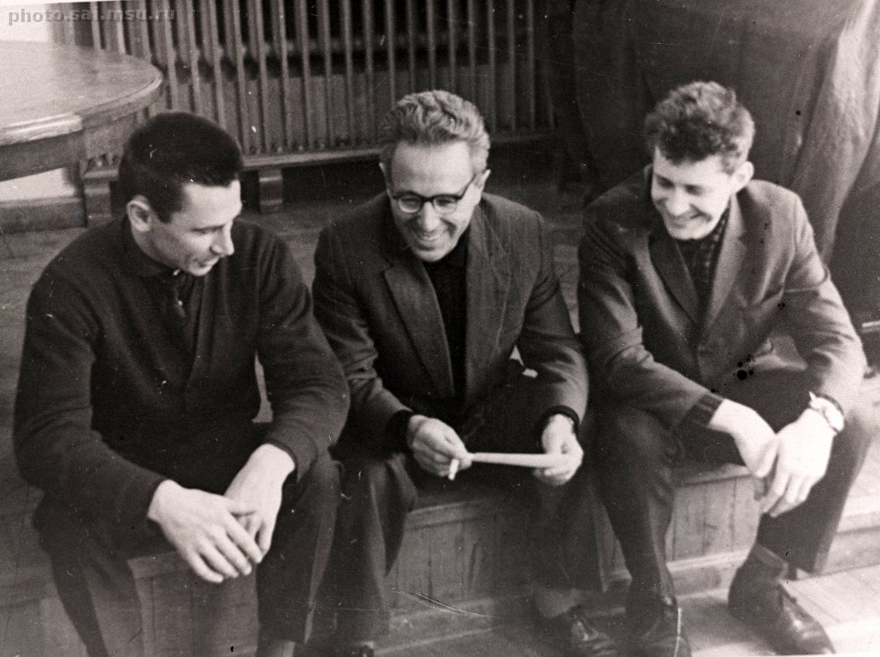

Slide 13
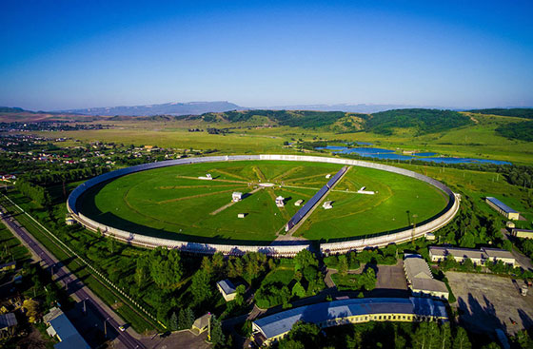
RATAN 600

Slide 14
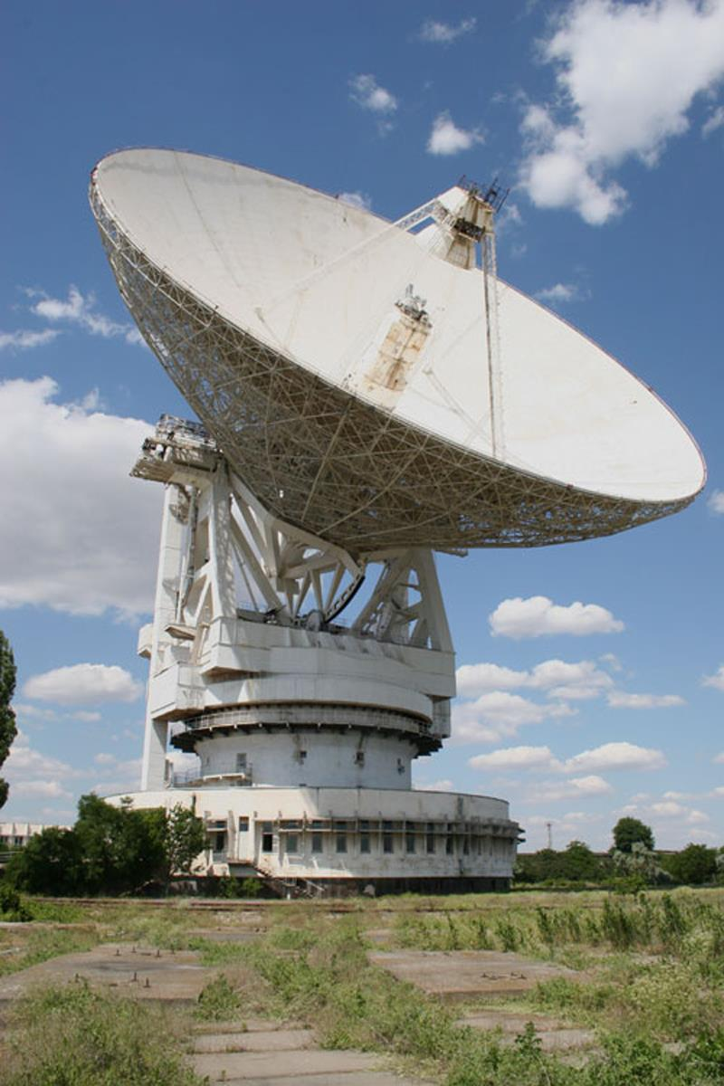
RT-70 (Evpatoria) Another RT-70, usable down to 1mm wavelength, was being constructed on Suffa plato (Uzbekistan) in 1980-s, under supervision of N. Kardashev. The project was not completed because of the break of the Soviet Union.

Slide 15
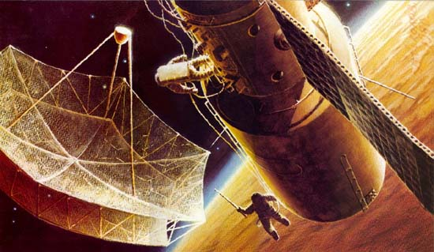
KRT-10

Slide 16
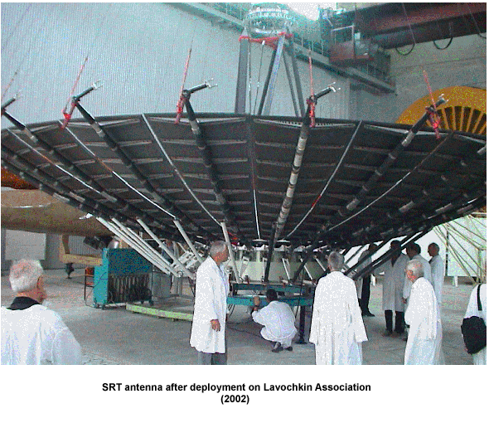
The 10-m antenna of RadioAstron

Slide 17
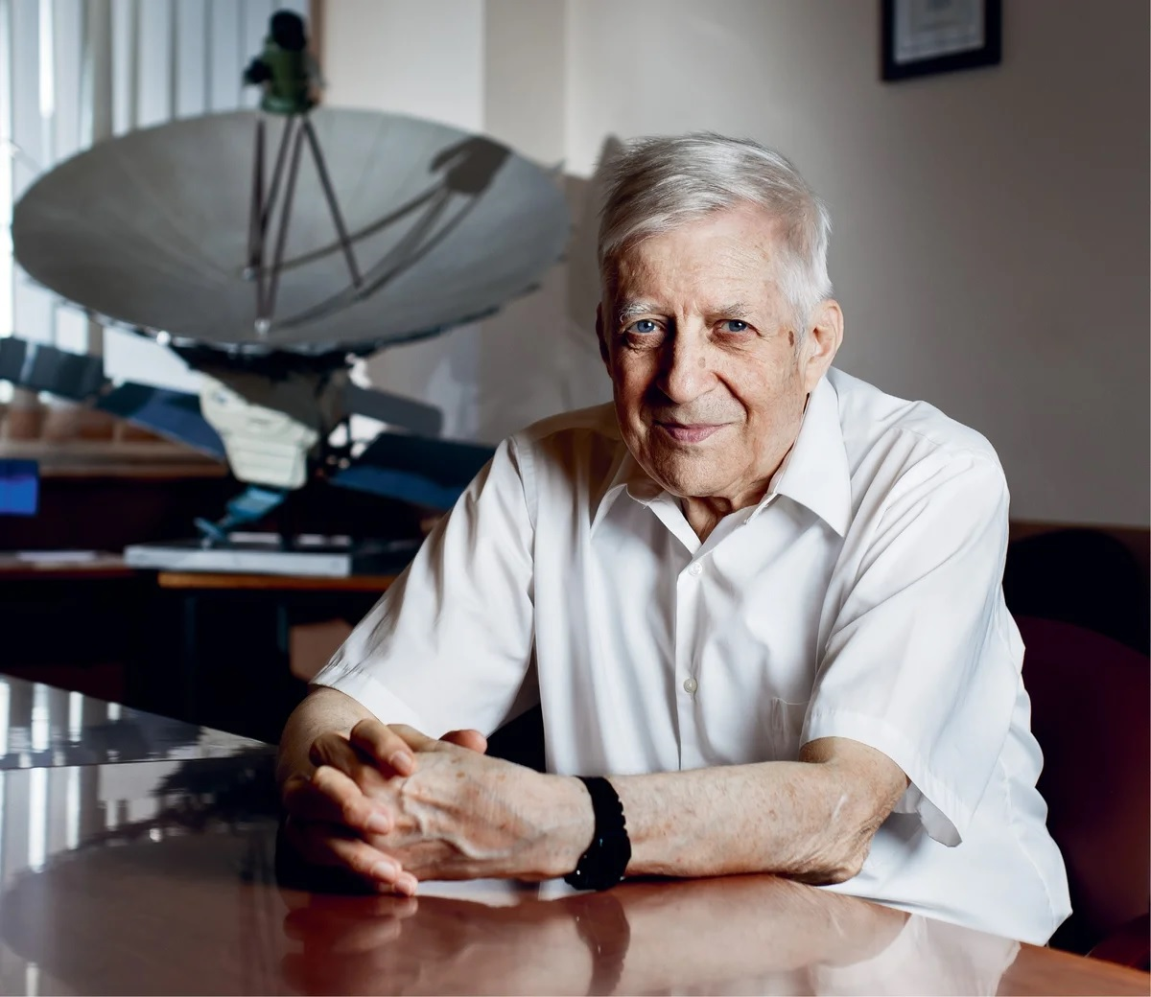

Slide 18
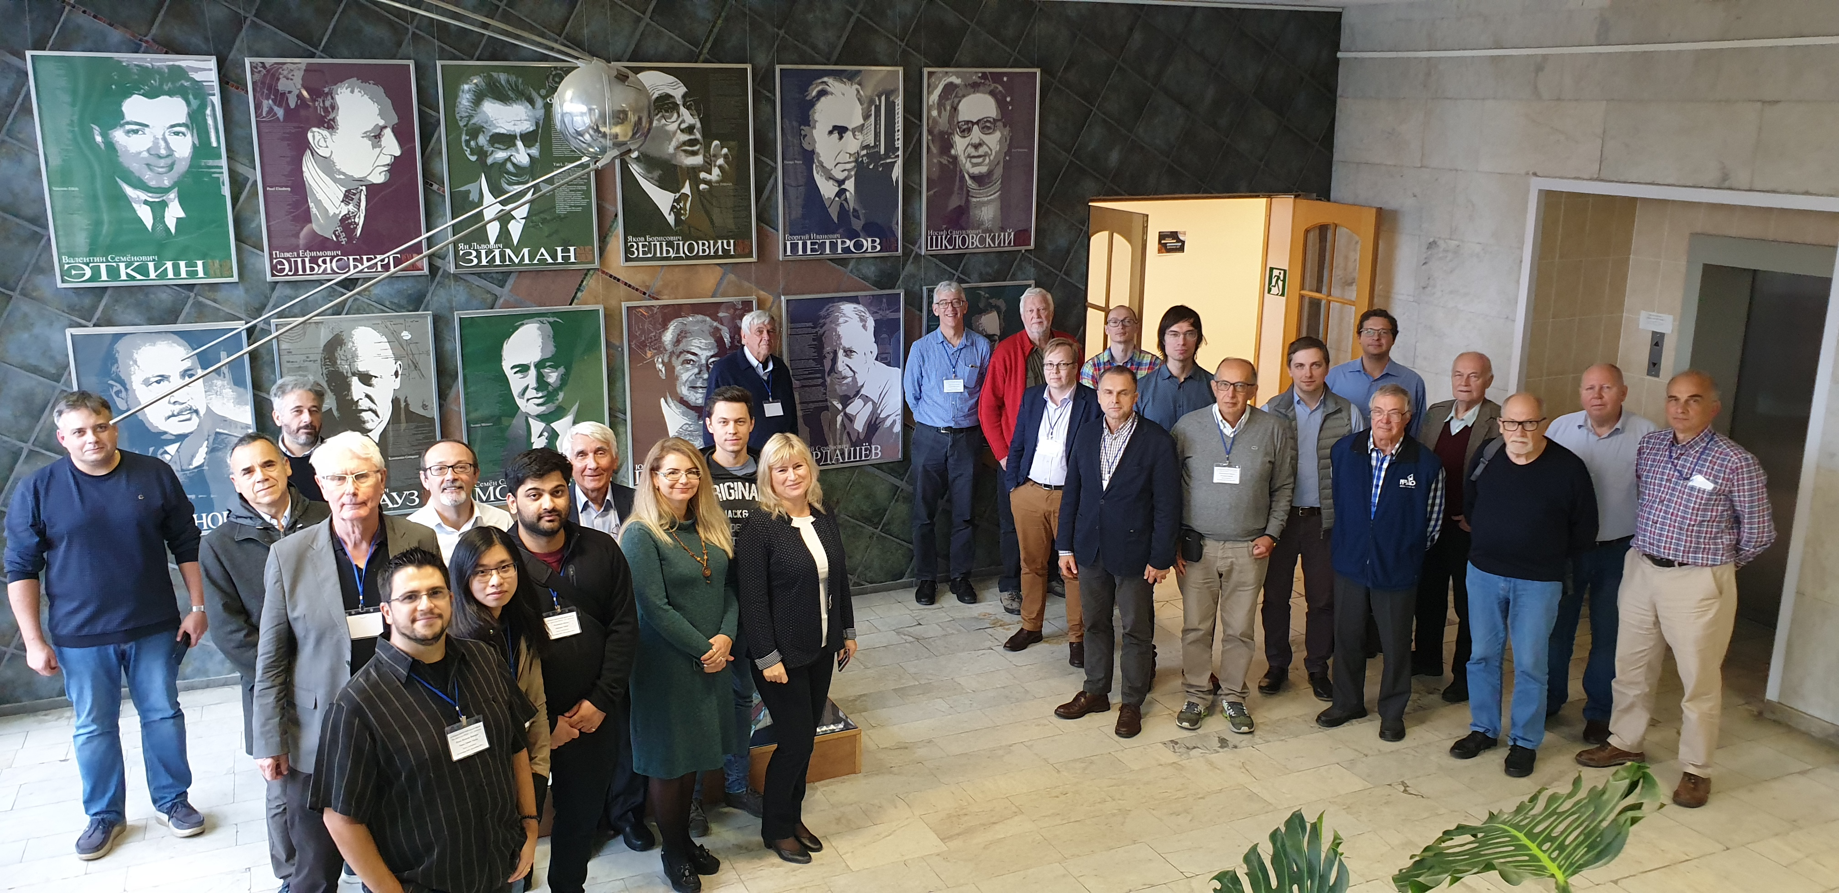
RadioAstron meeting October 2019

Slide 19
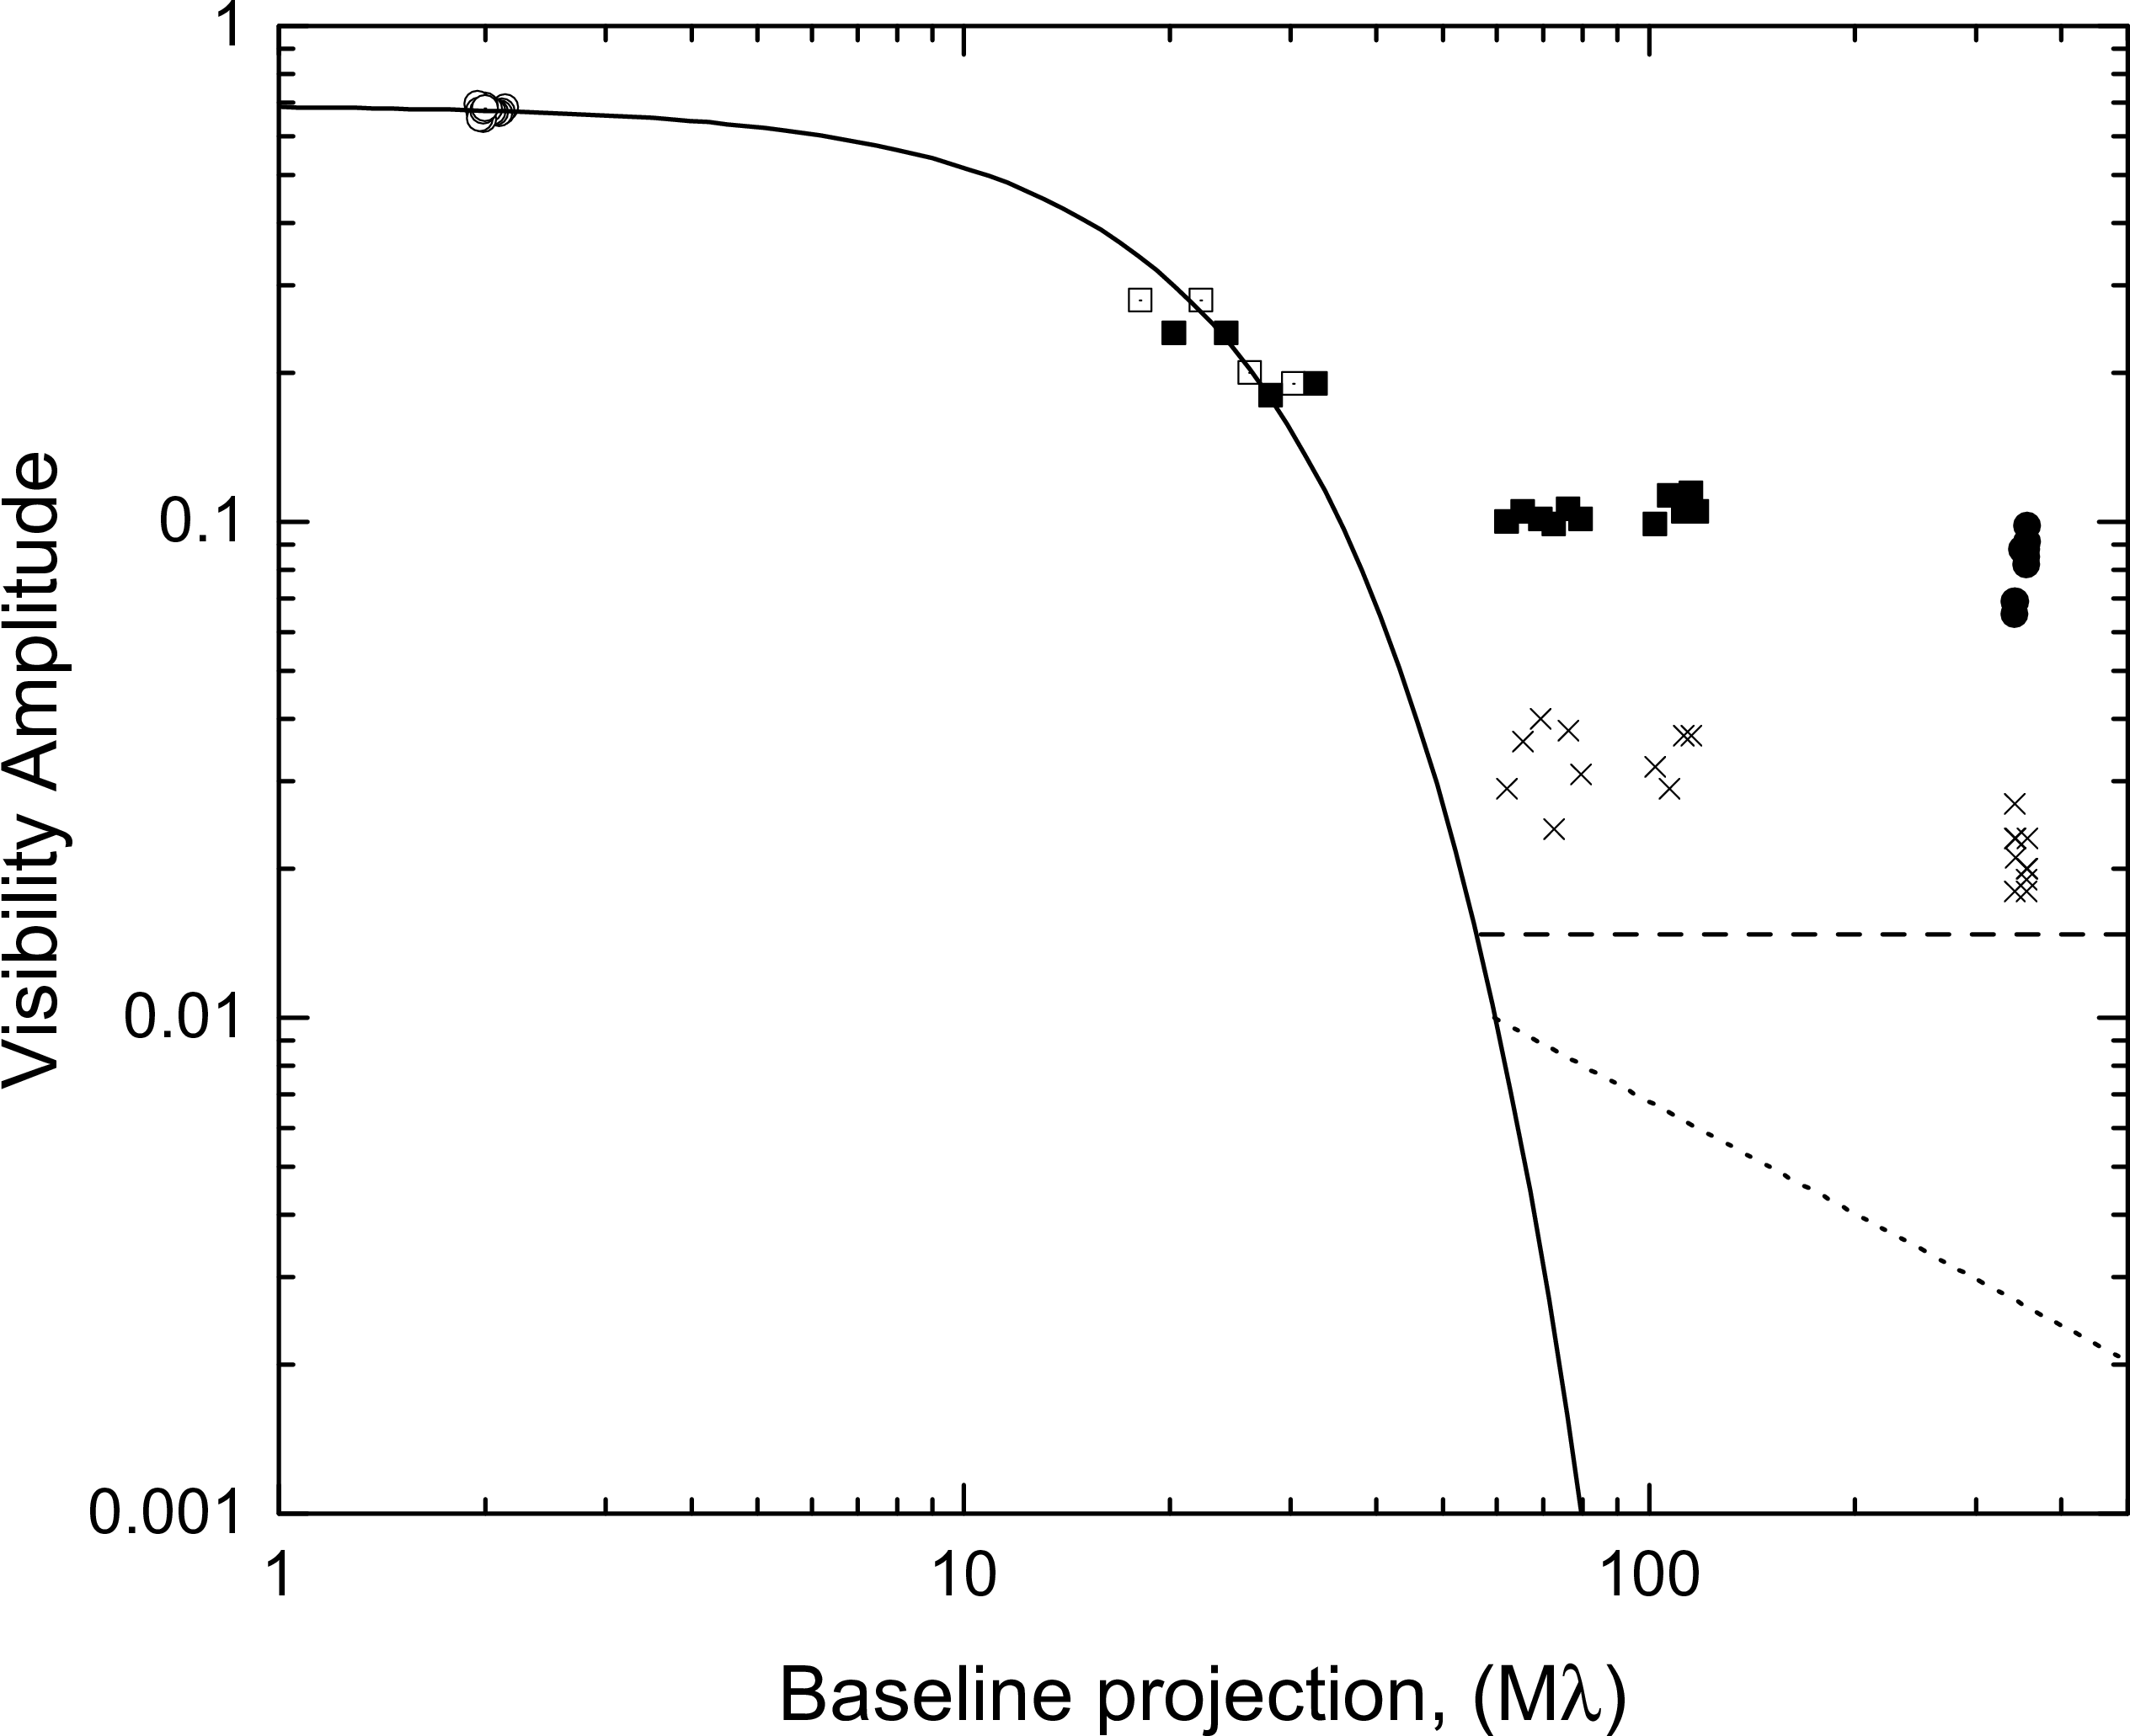
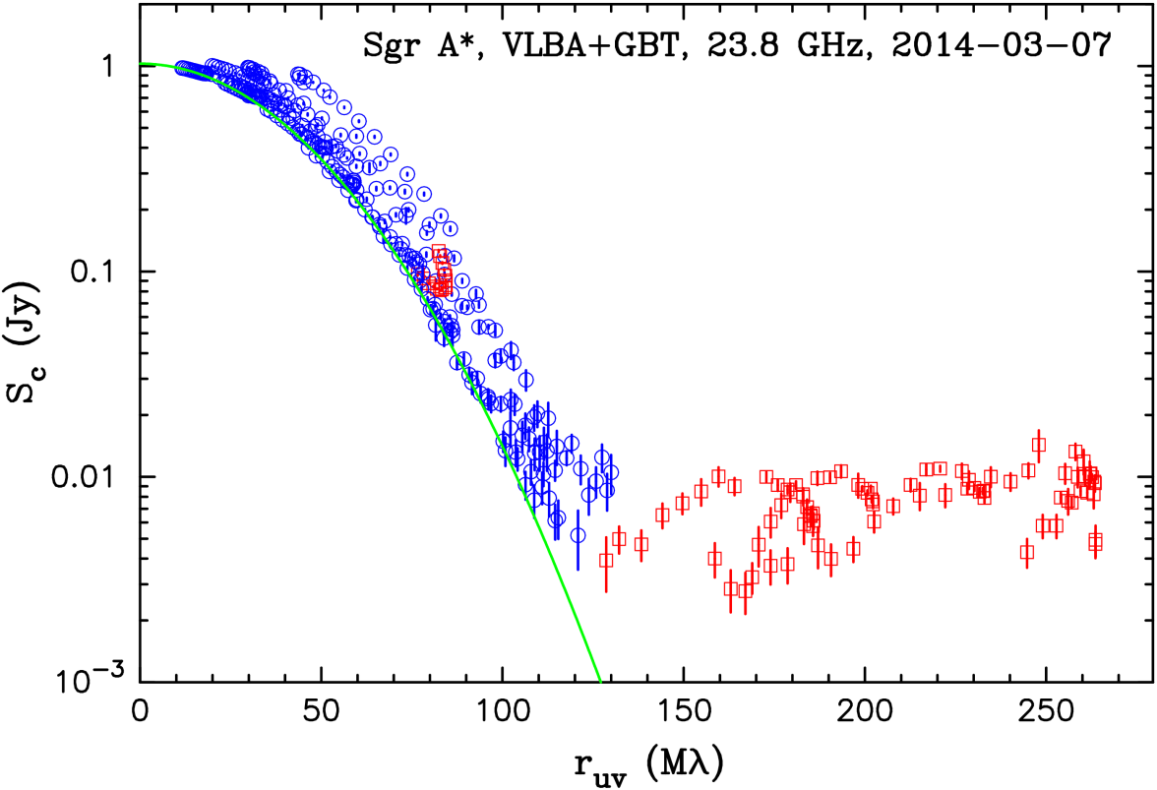
Discovery of the scattering sub-structure
0.3 GHz
PSR 0329+25
RadioAstron
Scattering disk:
3.6 mas
Popov et al. (2017)
Gwinn et al. (2014)
A tool to probe turbulent interstellar medium.
Must be taken into account by RadioAstron and Event Horizon Telescope.
A new promising tool to reconstruct the background source true image.
Model

Slide 20
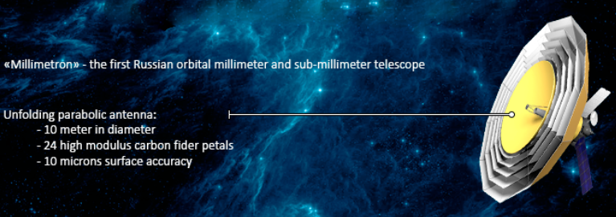
Millimetron (2026?)

Slide 21
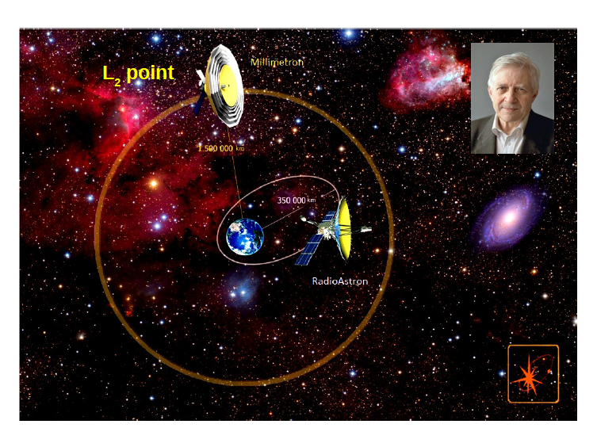

Slide 22
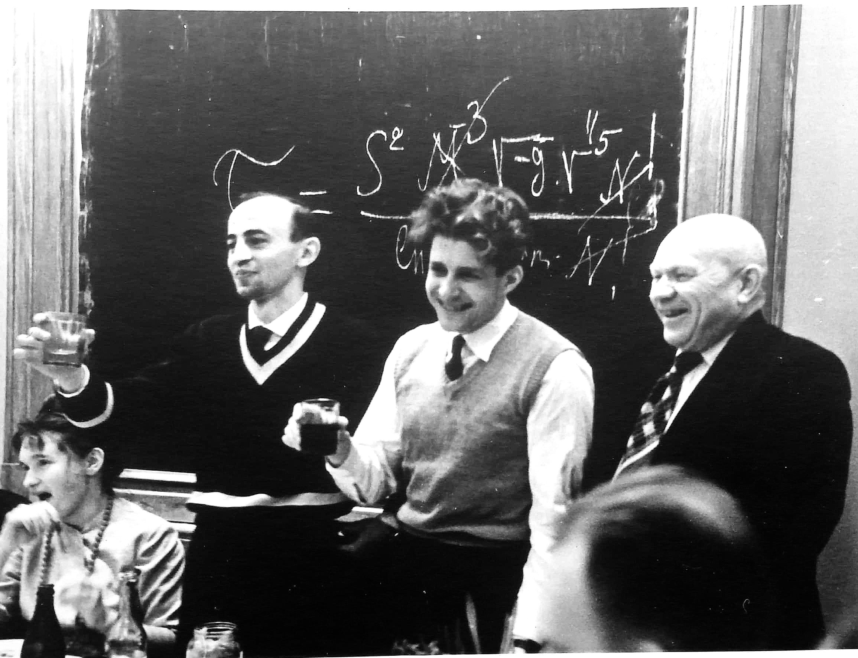

Slide 23
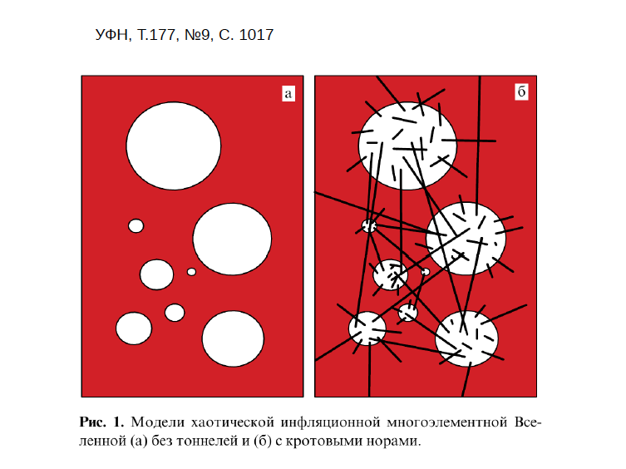
Model of universes in the Multiverse – without and with wormholes

Slide 24
Contributions to SETI
Kardashev Scale
Optimal frequency domain for search
Probable spectrum of an artificial source
Criteria of artificiality
Several sky surveys at cm and dm wavelengths
Development of facilities for observational astrophysics and SETI

Slide 25
Contributions to Astrophysics
Radio Recombination Lines (“Kardashev Lines”)
Theory of evolution of radio sources
Prediction of a neutron star in the center of Crab (before the discovery of pulsars)
VLBI (together with Matveenko and Sholomitsky)
A pioneer and leader of Space Radio Astronomy
Contribution to cosmology (together with I.D.Novikov), in particular, the possibility of wormholes between universes in the Multiverse

Slide 26
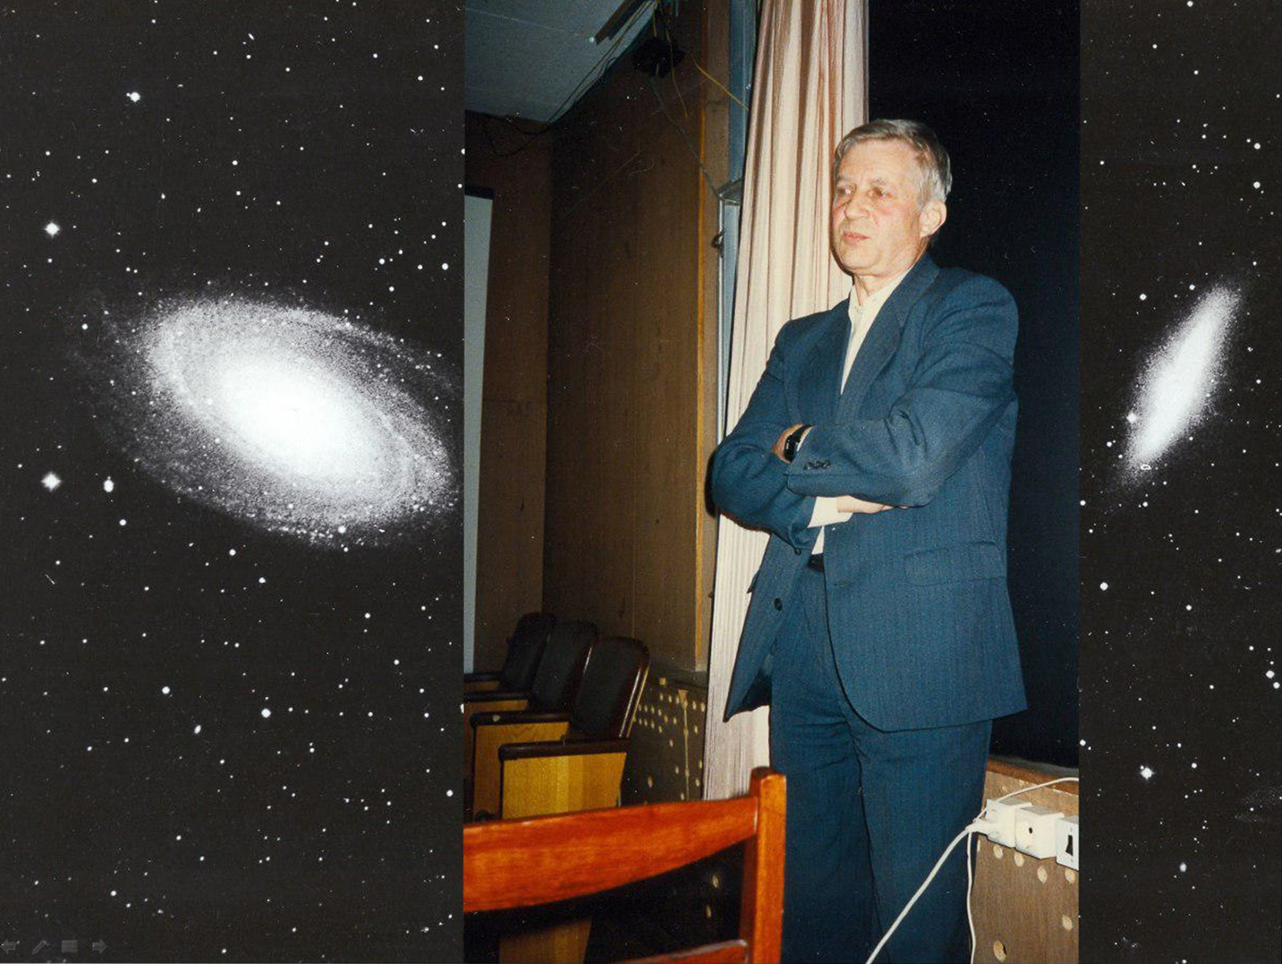
The notions of morals and good are universal, like the Pythagoras theorem. Civilizations do not survive, if they behave otherwise.
Nikolay Kardashev

Slide 27
Kolya
Nikolai Semionovich Kardashev
remembered by:
L. Fillippova, L. Gindilis, L. Gurvits,
Yu. Kovalev, S. Likhachev,
and V. Strelnitski

